Slide 1

Marketing
Real People, Real Decisions
Third European Edition
Topic 09
Place (Distribution)
Ref.: Chp. 12 of the textbook

Slide 2
Objectives
Understand what a distribution channel is and what functions distribution channels perform (slide 3 to 8)
Describe the types of distribution channel (slide 9 to 11)
Discuss channel conflicts and different types of marketing system (slide 12 to 18)
Shed light on steps in distribution planning (slide 19 to 26)
Discuss wholesaling and retailing (slide 27 to 38)
Discuss some recent trends in retailing (slide 39 to 40)

Slide 3
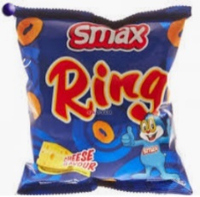
What is a distribution channel?
A distribution channel is a series of firms or individuals that facilitates the movement of a product from the producer to the final customer.
A distributor (also called intermediary) is an individual firm/ person that distributes products to customers.
Retailer 1
Consumers
Producer
Wholesaler A
Retailer 2

Slide 4
Functions of distributor (intermediary)
Time, place and ownership utilities
Logistics functions
Transportation and storage functions
Facilitating functions
Repair and maintenance functions
Risk-taking
Communications and transaction functions.

Slide 5
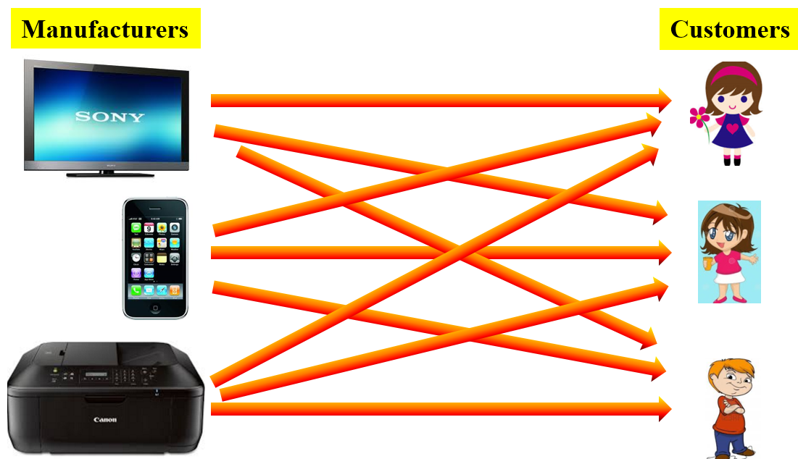
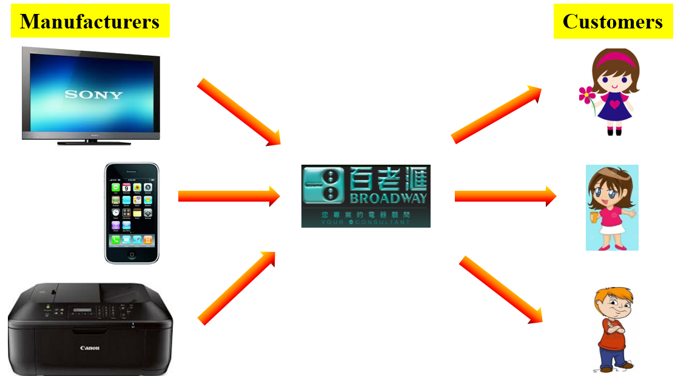
Functions of distributor (intermediary)
Time, place and ownership utilities
Efficiency creation
Consider three persons: Amy, Carmen, and Eric. Each wants to purchase a Sony TV set, Apple’s i-Phone, and a Cannon’s printer.
Case 1: Without intermediary
Case 2: With an intermediary
9 contacts are required!
Only 6 contacts are required!

Slide 6
More on efficiency creation
Breaking bulk: channel members purchase large quantities from manufacturers and sell smaller quantities to many different customers.
Creating assortments: channel members provide a variety of products on one location.

Slide 7
Functions of distributor (intermediary)
Logistics functions
Facilitating functions: make the purchase process easier
Repair and maintenance functions
e.g.: Transportation and storage
e.g.: offers credit (instalment) to customers;
Serve as an authorized repair center

Slide 8
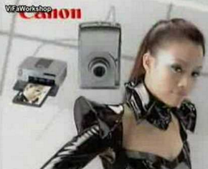

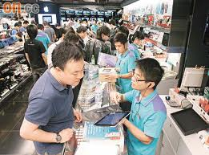
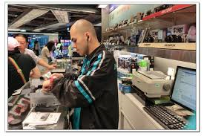
Functions of distributor (intermediary)
Risk-taking function
Communications and transaction functions
e.g.: TV ads by Broadway
e.g.2: Front-line staff listen to customers and introduce suitable products

Slide 9
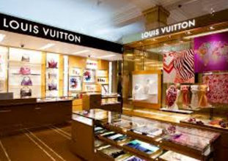
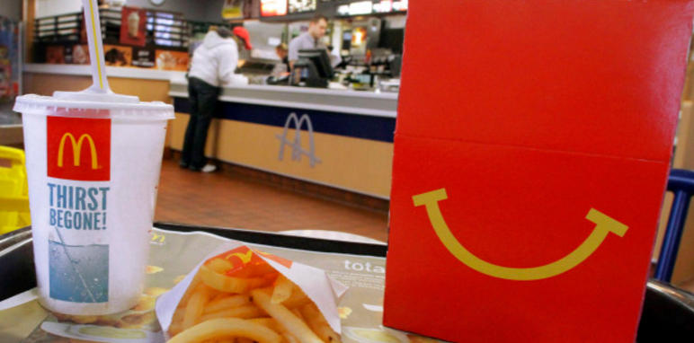
Types of distribution channel: Direct distribution channel
A direct distribution channel has no intermediary levels; the company sells directly to consumers.
Final customers
Producer
e.g.: Producers deliver their products/ service through their own:
retail stores
(e.g.: restaurants)

Slide 10
Types of distribution channel: Indirect distribution channel
An indirect distribution channel contains one or more intermediaries.
From the producer’s point of view, a greater number of levels mean less control and greater channel complexity.
Channel conflict
One layer of marketing intermediaries
Producer
Retailer(s)
Final customers
e.g.: A snack producer→ 759 store → consumers
Two layers of marketing intermediaries
Producer
Wholesaler(s)
Retailer(s)
Final customers
e.g.: Coca cola company → various retailers → consumers

Slide 11





Types of distribution channel: Multiple (dual) distribution system
Multiple (dual) distribution system refers to a distribution in which a single firm sets up two or more distribution channels to reach one or more customer segments.
A Simple Example
Clinics & hospitals
Consumers
Producer
Retailers

Slide 12




Channel Conflict
Channel conflict refers to disagreement among channel members.
Example
Various retailers
Final customers
Normal retail price of coco-cola:
Over $5 per bottle

Slide 13
Three Major Types of Marketing System
Whether channel conflicts can be avoided depends on types of marketing system.
Conventional Marketing System
Horizontal Marketing System
Vertical Marketing System (VMS)
Corporate VMS
Administrated VMS
Contractual VMS

Slide 14
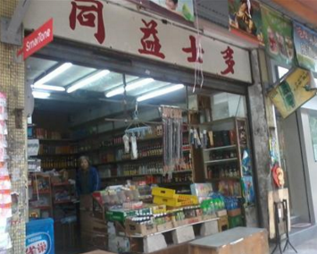
Three Major Types of Marketing System
Conventional marketing system is an indirect distribution system that consists of channel members who work independently, seeking to maximize its own profits (perhaps at the expense of the system as a whole).
Horizontal marketing system is a channel arrangement in which two or more companies at the same level work together to get their product to the customer.
e.g.: snack producers→ many grocery stores

Slide 15
Three Major Types of Marketing System
Vertical marketing system (VMS) is a channel structure in which channel members at different levels cooperate with each other.
There are three major types of VMS.
Corporate VMS
Administrated VMS
Contractual VMS
Franchised VMS
Wholesale-sponsored
Retailer-cooperative
Producer
Wholesalers
Retailers
Consumers

Slide 16
Three Major Types of Marketing System
Corporate VMS is a vertical marketing system that combines successive stages of production and distribution under single ownership.
Administrated VMS is a vertical marketing system that channel members at different levels remain independent, but voluntarily work together because of the power of a single channel member (called channel leader/ channel captain/ category captain).
Contractual VMS is a vertical marketing system in which channel members at different levels work together through contracts that spell out each member’s rights and responsibilities and how they will cooperate.
One common type of contractual VMS is franchised VMS.
e.g.: Zara
Note: The channel leader is the dominant firm that controls the channel.
discussed next

Slide 17
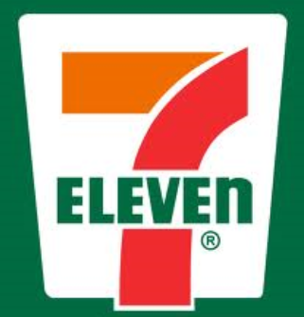
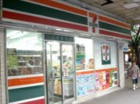
Three Major Types of Marketing System
Franchised VMS: the franchise organization is the most common type of contractual relationship. A channel member called a franchisor links several stages in the production-distribution process.
Royalty fee
You
Name, operating methods, relevant support

Slide 18
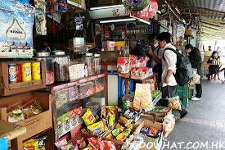
Three Major Types of Marketing System
ii. Voluntary chain: Wholesaler-sponsored groups of independent retailers engaged in bulk buying and common merchandising. e.g.: the Independent Grocers Alliance (IGA)
iii. Retailer cooperative: Groups of independent retailers who set up a central buying organization and conduct joint promotion effort. e.g.: Associated Grocers

Slide 19
Steps in distribution planning
Step 1: Develop distribution objectives
Step 2: Evaluate internal and external environmental influences
Step 3: Choose a distribution strategy
Step 4: Develop distribution tactics

Slide 20
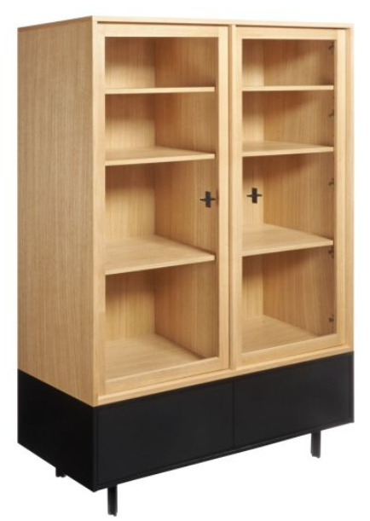
Step 1: Develop distribution objectives
More specific distribution objectives partly depend on the characteristics of the product and the market.
e.g.1: For bulky product → minimize shipping cost.
e.g.2: For convenience product → make yr. product widely available
e.g.3: For luxury product → deliver superior service

Slide 21
Step 2: Evaluate internal and external environmental influences
Internal environment
External environment
e.g.: Hv. own retail and online store?
e.g.: Intermediaries (e.g.: Park-n-shop? Wellcome? 759?)
What products they distribute?
Slotting fee （上架費）? Any other fee?
Procedure for entering the intermediaries

Slide 22
Step 3: Choose a distribution strategy
Planning distribution strategies involve a number of decisions.
The number of levels in the distribution channel:
no level (i.e.: direct distribution channel); one, two or more levels of intermediaries (i.e.: indirect distribution channel)?
If use intermediaries, how many?
Intensive distribution
Exclusive distribution
Selective distribution
If use intermediaries, what is the relationship with them (i.e.: marketing system)?
Conventional marketing system
Vertical marketing system (VMS)
Horizontal marketing system
As discussed next
As discussed in slide 13 to 18

Slide 23
Step 3: Choose a distribution strategy
Number of intermediaries (if any)?
many (intensive distribution)?
A producer stocks its products in as many outlets as possible.
Few (exclusive distribution)?
A producer gives a single intermediary the exclusive right to distribute the company’s products in their territories.
In between (selective distribution)?
A producer gives more than one, but fewer than all, of the intermediaries who are willing to carry the company’s products.
e.g.: producers of convenience goods (like soft drink, snack)
e.g.: producers of shopping goods (like digital camera)

Slide 24
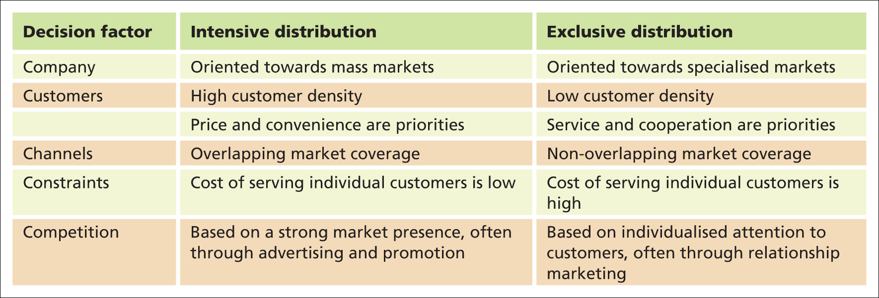
Characteristics that favour intensive over exclusive distribution
e.g.: build good relationship w. individual customers
Notes:
Table 12.2 Characteristics that favour intensive over exclusive distribution

Slide 25
Step 4: Develop distribution tactics
The final step in distribution planning is to develop the distribution tactics necessary to implement the distribution strategy. This involves:
Selecting individual channel members
Managing the channel

Slide 26
Step 4: Develop distribution tactics
Selecting individual channel member: Some considerations
Does the position of your product match that of a potential channel member?
Does a potential channel member contribute to the service customer want?
Managing channel members: Some tasks:
Supply products to your distributors, such that your distributors are able to maintain inventory level necessary to satisfy customers while avoiding ordering errors
Handle channel conflicts

Slide 27

Two major types of distributor
Wholesalers
Wholesaling includes all activities involved in selling goods and services to those buying for resale or business use.
Wholesalers: firms engaged primarily in wholesaling activities. In other words, such firms buy mostly from producers and sell mostly to retailers, business customers and other wholesalers.
Retailers
Retailing includes all activities involved in selling goods or services directly to consumers for their personal, non-business use.
Retailer is a business whose sales come primarily from retailing.
Consumers

Slide 28
Classification of wholesalers
Independent intermediaries
Merchant Wholesalers
Full-service wholesaler
Limited-service wholesaler
Brokers (經紀) and Agents (代理)
Manufacturers-owned intermediaries

Slide 29
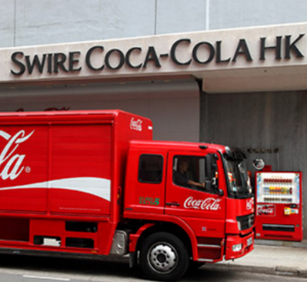
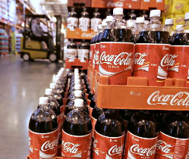
Classification of wholesalers
1A. Merchant Wholesalers
The largest group of wholesalers, accounting for roughly 50 percent of all wholesaling.
Take title to goods
Merchant wholesalers include two broad types:
Full‑service wholesalers provide a full set of services. (e.g.: offer warehousing service, transport products to retailers/ business customers)
Limited‑service wholesalers offer fewer services to their suppliers and customers. (e.g.: no warehousing service, no delivery)
Meaning: Wholesalers buy goods and therefore they have ownership of such goods

Slide 30
Classification of wholesalers
1B. Brokers (經紀) and Agents (代理)
Brokers and agents differ from merchant whole­salers in two ways:
They do not take title to goods,
They provide service in exchange for commission.
A broker brings buyers and sellers together and assists in negotiation.
Agents represent buyers or sellers on a more permanent basis.
On a short-term basis!
e.g.: stockbrokers in securities firms
e.g.: insurance agents
Explanation:
Stockbrokers in securities firms:
If you want to buy a company’s stock, say, stock of HSBC, you can ask a stockbroker to do transaction for you. But once the transaction is completed, the stockbroker may not take any follow-up action. He or she doesn’t care whether you win money or not. As you can see, stockbroker serves customers on a short-term basis—on a short-term basis. So, stockbroker is one example of broker.
Insurance agents:
Insurance agents serve customers for a relatively long time, say, for many years. For instance, if you get injured, you can ask your insurance agents to follow up, say, claim compensation. As you can see, insurance agents serve customers on a more permanent basis—on a permanent basis, say, for many years. That’s why such people belong to agents.

Slide 31


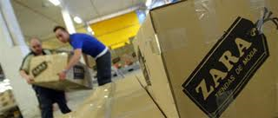
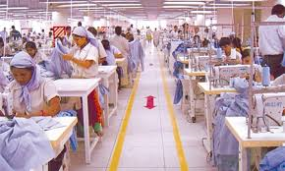
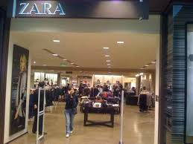
Classification of wholesalers
Manufacturers-owned intermediaries are the wholesaling operations conducted by sellers (or buyers) themselves rather than through independent wholesalers.
e.g.: Distribution center owned by Zara
Customers

Slide 32
Classifying retail stores
The classification of retail stores provides a method by which retailers understand the possible ways that they might offer their product in the market.
Two ways of classification methods
Classifying by level of service
Classifying by merchandise selection (assortment).

Slide 33
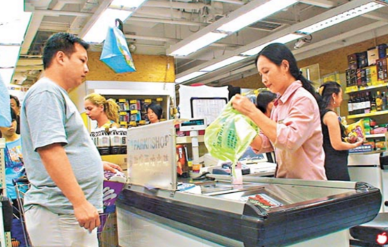
1. Classifying by level of service
Retailers differ in the amount of service provided to consumers.
Self-service retailers serve customers who are willing to perform their own “locate-compare-select” process to save money.
Limited-service retailers provide moderate sales assistance.
Full-service retailers provide high-level sales assistance.

Slide 34

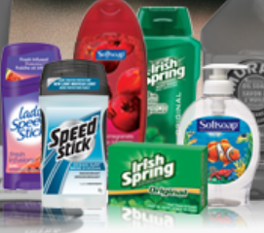
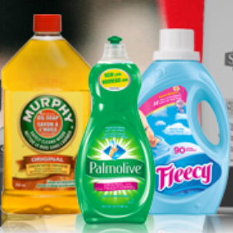
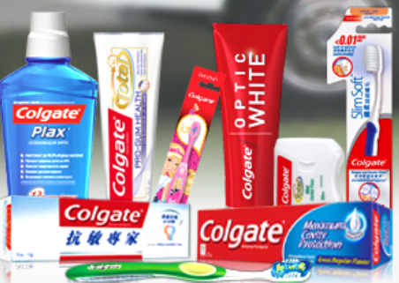
2. Classifying retailers by merchandise selection (assortment)
Another way to classify retailers is in terms of merchandise assortment, which has two dimensions: breadth and depth.
Merchandise breadth (or variety) is the number of different product lines available.
Some terminologies:
Broad assortment → many product lines
Narrow assortment → few product lines
Merchandise depth is the variety of choices available for each product line.
Some terminologies:
Deep assortment → many items within a product line
Shallow assortment → few items within a product line
Personal care products
Home care products
Oral care products

Slide 35

2. Classifying retailers by merchandise selection (assortment)
Based on merchandise selection, some major forms of the retailers are the following:
Specialty shop is a store that has a relatively narrow and deep stock of goods.
e.g.: Marathon Sports (馬拉松)
Product line: Sport Apparel
Assortment: basketball, running, football appeals (with different sizes and color) etc…
Other examples: clothing stores, video game stores, jewellery stores

Slide 36
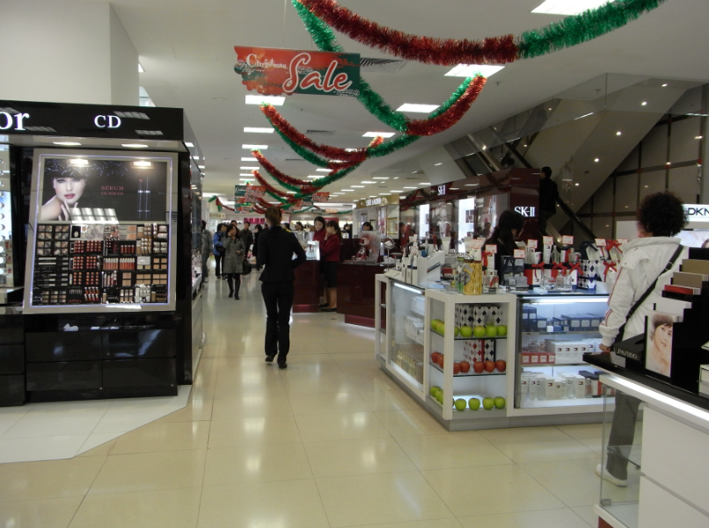
2. Classifying retailers by merchandise selection (assortment)
Department store sells a broad and deep assortment of items organized into different sections of the shop.
e.g.: Sogo, Wing On

Slide 37
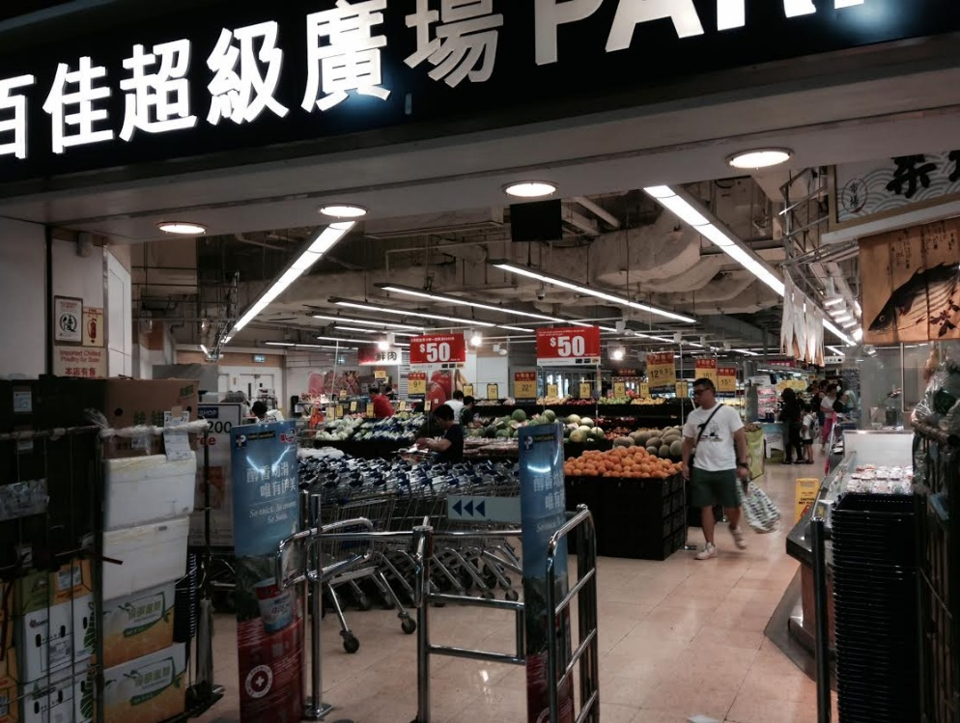
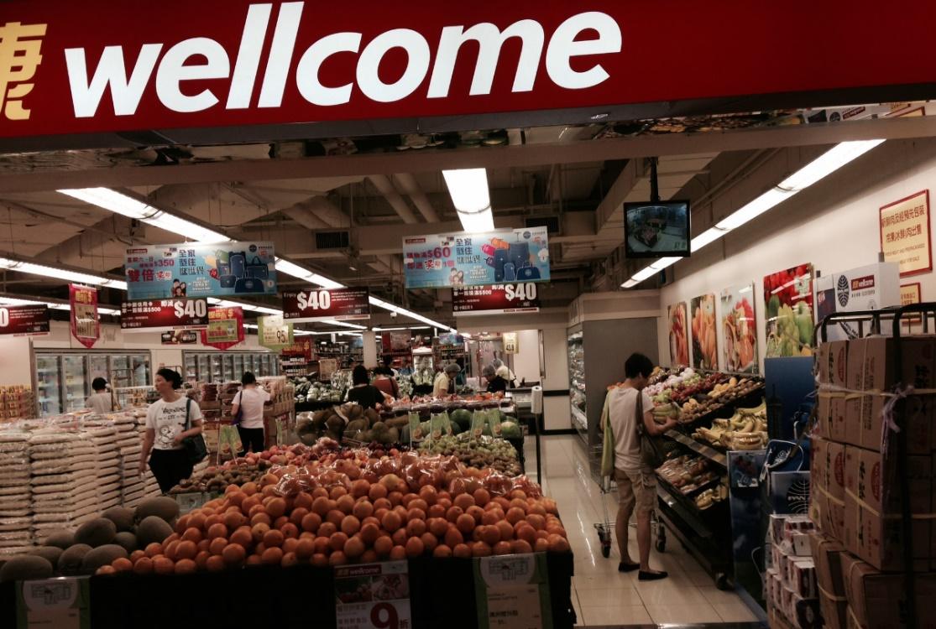
2. Classifying retailers by merchandise selection (assortment)
Convenience store is a store that carries a limited number of frequently-purchased items. e.g.: 7-eleven, Circle K, V>nGO
Supermarket is a large, low-cost, low-margin, high-volume, self-service store that carries a wide selection of grocery and household products. e.g.: Park-n-shop

Slide 38

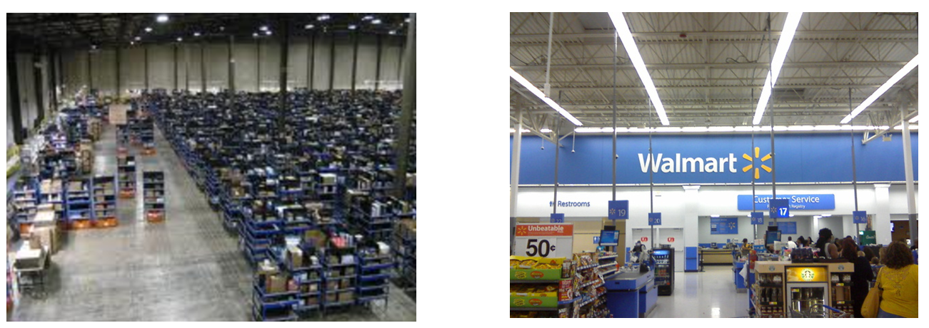
2. Classifying retailers by merchandise selection (assortment)
Hypermarket is very large (50,000 to 80,000 square meters) and combines the characteristics of warehouse and supermarket.

Slide 39
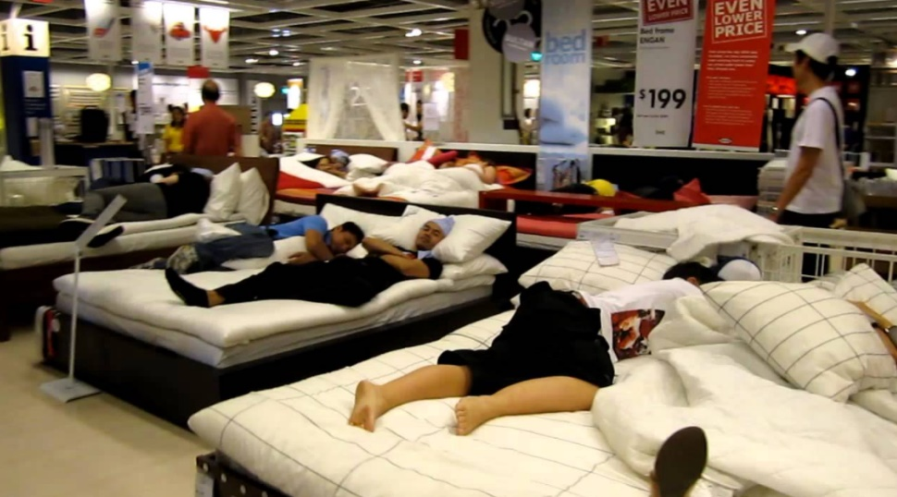
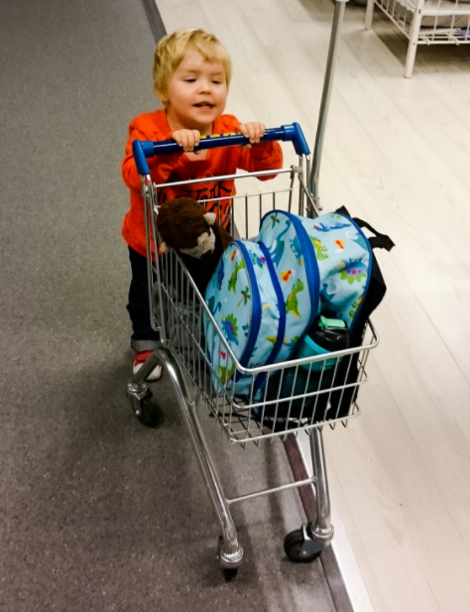
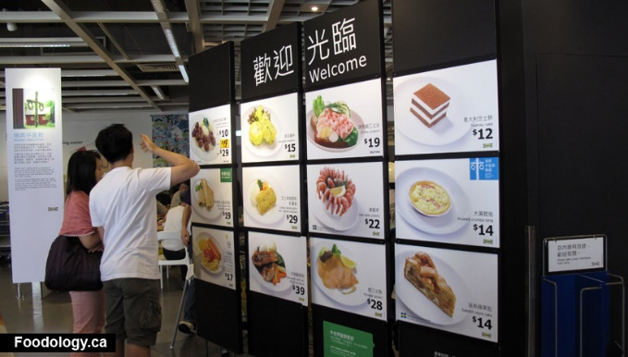
Some recent trends in retailing
Trend 1: Shopper marketing
Many marketers are now embracing the concept of shopper marketing, which refers to the idea that the retail store itself is an important marketing medium.

Slide 40

Some recent trends in retailing
Trend 2: Online retailing
Even small firms with limited resources can enjoy competitive advantages by making products available to customers around the globe at a very low cost.
Disintermediation – process by which traditional intermediaries are eliminated as companies question the value added by layers in the distribution channel.
Much of the anticipated growth in online sales will go to multichannel retailers—the click-and-brick marketers who can successfully merge the online and physical stores.

